Slide 1
Charlie’s Spring Term Presentation
y
B
Charlie
Hatch

Slide 2
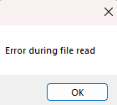
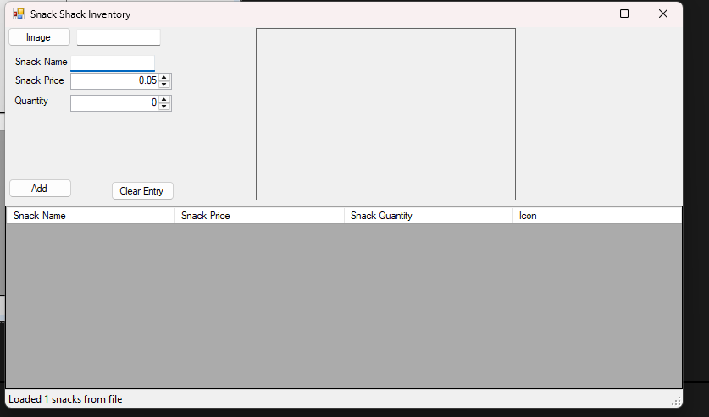
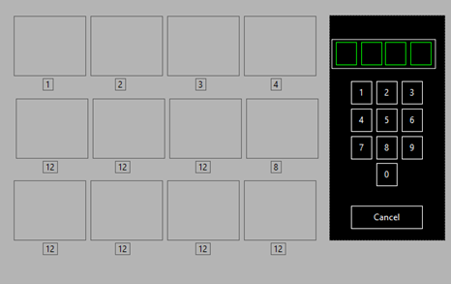
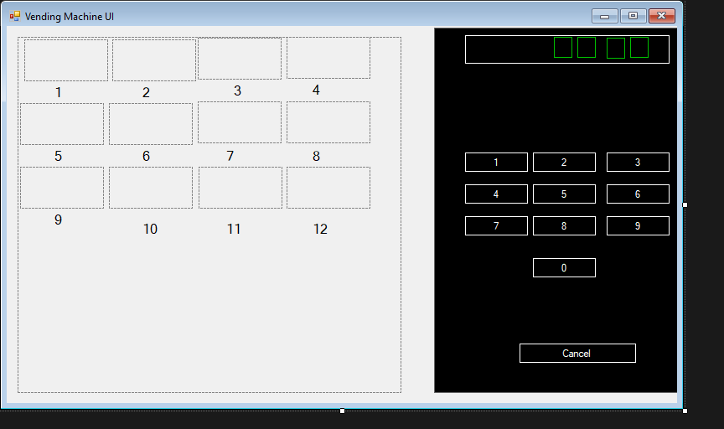
Tech: Advanced app-dev
We worked on two things in advanced appdev.
One of the projects we worked on was the Snack Shack
In actuality, the most major was, as discussed by Ryan, actually databases and SQL. But I figured you have heard about that from him
Tasks used:
Debugging
Debugging
Debugging
Okay, in all seriousness
Critical Thinking
Trial and Error
"Art"
As for what I gained, it’s mostly just more knowledge, in this case about SQL
Notes:
After third debugging, say the “those are my 3” joke
Art skills = purchaseing interface

Slide 3
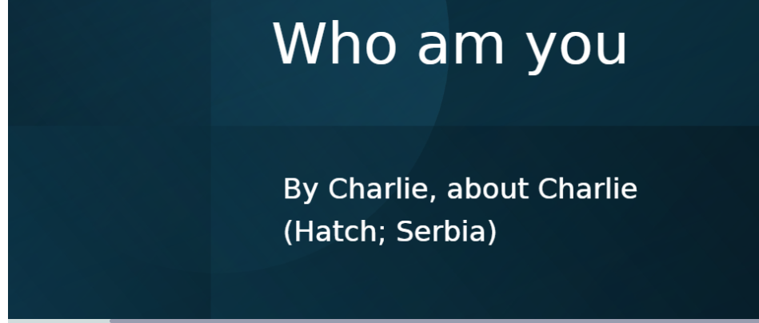

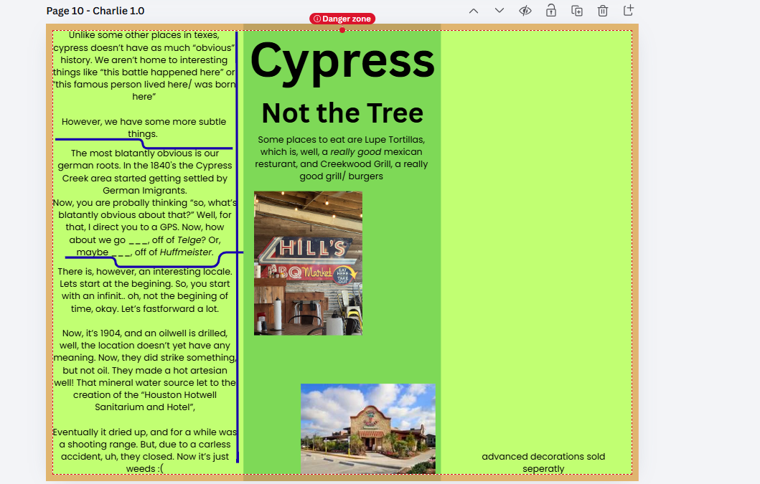
Core: Community
In community, we learned about, well, our community.
While not inherently a skill:
I learned more about the greater Houston area
I made a nice slideshow about Charlie Serbia called “who am you”
We also worked on a pamphlet about our area. One of the parts I did was about cypress (not the tree)
I didin't finish it, but I started on one about the ship channell, which just flowed on in!
As for how I’d use it, well, it just helps to know what’s around you so you can actually do things. Basically, less “use it” and more “add more things to use skills on”
Notes:
for “who am you”, explain the whole “the questions where in first person”
Explain reason chose shipchannel?

Slide 4
Club: star-trek club
Well, while there where many good memorys, I think one of my favorites had to have been some of the discussions we had about Data, specifically the fact that he does have emotions, contrary to his own statments
Notes:
More deltais on discussions?

Slide 5
Favorite memory
Well, this term wasn't that memorable, honestly. So, I'm going more with what I did that I'm most proud of.
That is my "dynamic file path" system. There's no easy way show an image of it, but long story short basically it allows saving a file within the inside of a programs folder structure.

Slide 6
And now, what you have all been waiting impatiently for:
Fooled ya!
...
The End
Thanks for watching!
Now, for reall this time: The end!

